Slide 1
Tally
Presented
By
Srinivasan

Slide 2
8 (Eight) Type of Transactions in Tally

Slide 3
1.Purchase
2.Sales
3.Receipt
4.Contra
5.Payment
6.Sales return
7.Purchase return
8.JV ( journal entry)

Slide 4


1.Purchase

Slide 5

2.Sales

Slide 6

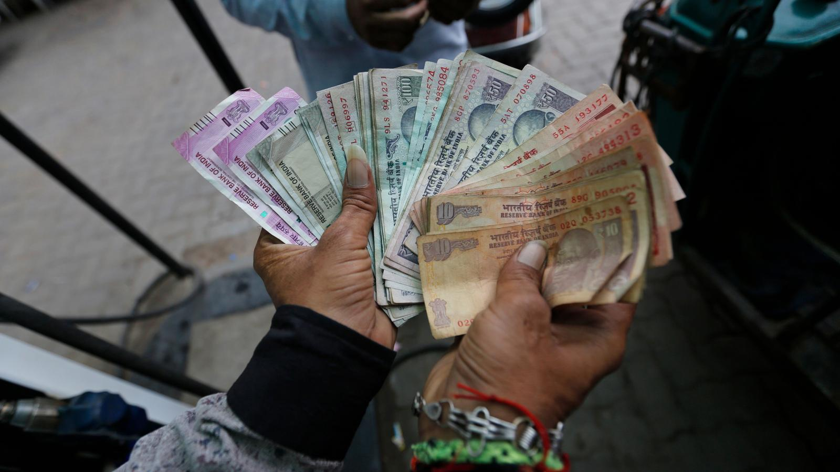
3.Receipt

Slide 7


4.Contra

Slide 8


5.Payment

Slide 9

6.Sales return

Slide 10

7.Purchase return

Slide 11
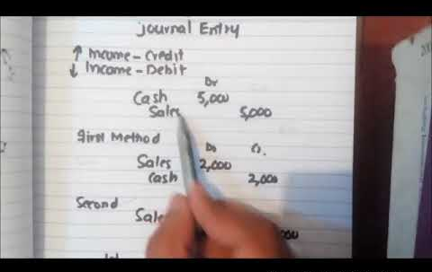
8.JV ( journal entry)

Slide 12
S.No | Type of transactions | Cash impact | debit | credit | Shortcut key
1 | Purchase |  | Purchase A/c | Cash A/c or Sundry Creditors A/c | F9
2 | Sales |  | Cash A/c Debtor A/c | Sales A/c | F8
3 | Receipt |  | Cash A/c | Giver | F6
4 | Contra |  | Where money goes | From which Account | F4
5 | Payment |  | Receiver | Cash A/c | F5
6 | Sales return |  | Sales A/c | Cash A/c | Ctrl + F8
7 | Purchase return |  | Cash A/c | Purchase A/c | Ctrl + F9
8 | J V ( journal entry) |  | Ref. situation and apply as per Golden rule. |  | F7

Slide 13
4.Contra

Slide 14
Contra
A/c Transfer
Deposit
Withdraw

Slide 15
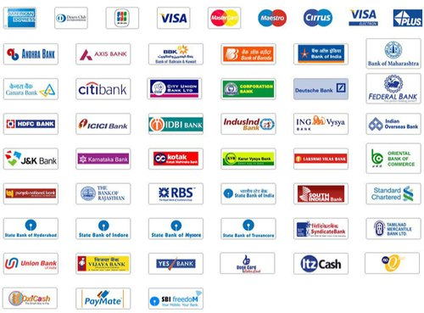

If you have Multiple bank account

Slide 16
Debit :
Where money goes
Credit :
From where?

Slide 17
S.No | Transactions | Dr | Cr
1 | Canara bank - Dr | 1000
 | To cash (Deposit) |  | 1000
2 | Cash - Dr | 5000
 | To Indian bank (Withdrawn) |  | 5000
3 | Canara bank –Dr | 10000
 | To Indian bank (Interbank Transfer) |  | 10000

Slide 18
8.JV ( journal entry)

Slide 19
Journal entry example
Jamin & co.,
VR info Solutions
Mylapore
Computer purchase
4X30,000 = 1,20,000
Jc info solutions
Mylapore
Sales
4X40,000 = 1,60,000
S.No | Transactions | Dr | Cr
1 | Purchase A/c – Dr | 1,20,000
 | To VR info solutions |  | 1,20,000
2. | JC SOLUTIONS A.c Dr. 1,60,000 To Sales A.c 1,60,000
3 | VR info solutions -Dr | 1,20,000
 | To Jc Info solutions |  | 1,20,000

Slide 20
End
Thank You
By
Srinivasan

